Slide 1
ART 1600 – The Aesthetics of Architecture, Interiors, and Design Matthew Ziff, Associate Professor Fall 2015
Foundations of Architecture & Design
How does architecture and interior design do the things we want them to do?

Slide 2
How does architecture (and the designers who bring it into existence) do the things we want it to do?
Construction Methods and Techniques
Building Systems
Design Process
Human Behavior: Analysis and Influence
Space and Form
Color
Furniture, Fixtures and Equipment
Environmental Systems and Controls
Legal Regulations

Slide 3
All of these play a role in the creation of built spaces.
Remove any of these and a building becomes much less useable, safe and enjoyable.

Slide 4
Construction Methods & Techniques
The way a building or space, or even an object, such as a chair, is actually made:
hand made
machine made
mass produced
made on the project site
pre-fabricated in a factory or shop setting

Slide 5
How a building is constructed

Slide 6
Hand made one at a time, human touch, dimensional tolerances respond to human capability.

Slide 7
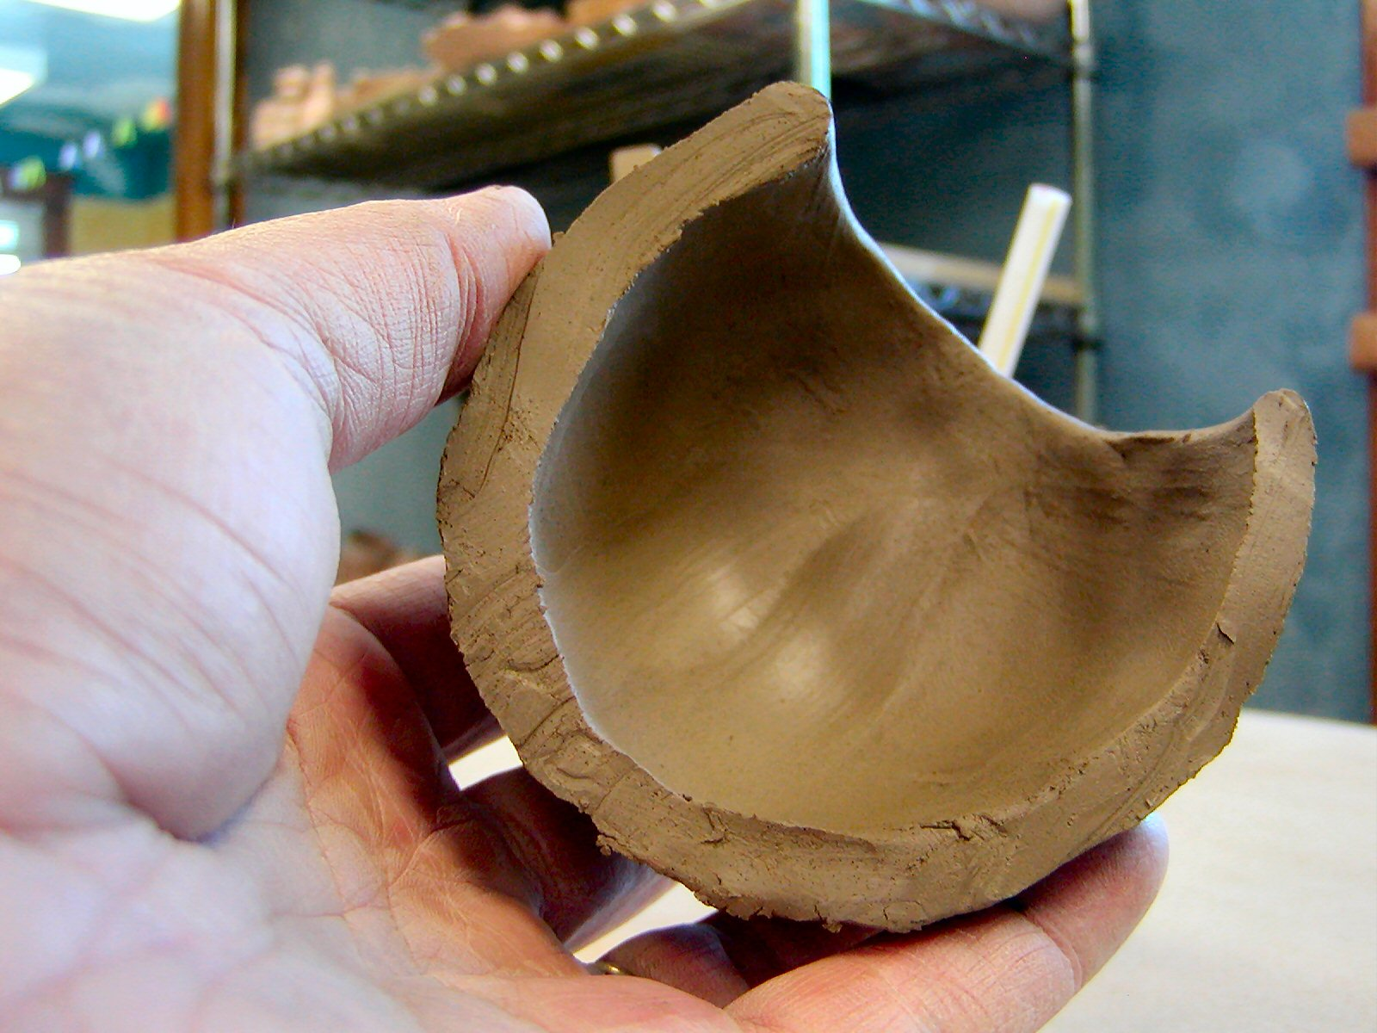
Hand made one at a time, human touch, dimensional tolerances respond to human capability.

Slide 8
Hand made one at a time, human touch, dimensional tolerances respond to human capability.

Slide 9
Hand made one at a time, human touch, dimensional tolerances respond to human capability.

Slide 10
Hand made wood drawers with dovetail joint

Slide 11
Hand made one at a time, human touch, dimensional tolerances respond to human capability.

Slide 12
Heavy timber framing (a structural wood frame made of large/heavy timbers)

Slide 13
Heavy timber framing

Slide 14
Concrete ‘tilt slab’ construction

Slide 15
Cast on site concrete wall being lifted into place concrete ‘tilt slab’ construction

Slide 16
Cast on site concrete wall being lifted into place concrete ‘tilt slab’ construction

Slide 17
Steel structural framework beams columns and roof rafters with pre-cast concrete floor panels

Slide 18
The melting point of steel is 3034 degrees F.
Wood with large cross sections take a long time to burn through.
Wood heavy timber can, depending upon the specific circumstances, resist fire better than unprotected steel.

Slide 19
Exposed to intense heat wood chars on the outer layers while steel collapses

Slide 20
A section of a glue laminated beam after burning for a specific period of time.

Slide 21
Mighty Ducks Ice Arena, Anaheim, CA arches made of glue laminated beams

Slide 22
Glue laminated beams small pieces of wood glued together to make a large piece

Slide 23
Glue laminated beams

Slide 24
Glue laminated beams

Slide 25
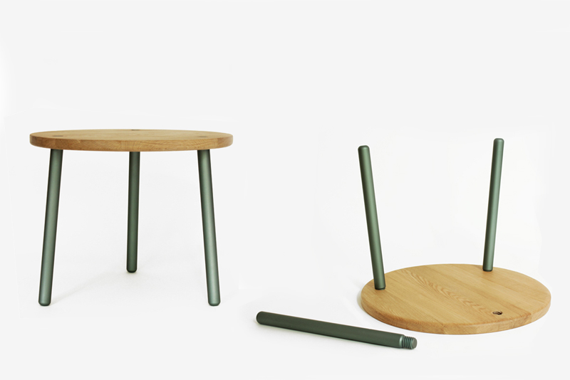
simple table top of wood with threaded rod fitted into threaded opening

Slide 26
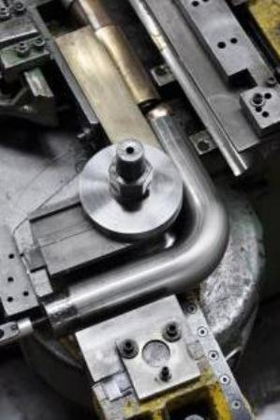
two different ways to bend metal tubing ask Igor, or use a machine!

Slide 27
Construction Methods & Techniques
specific materials require specific techniques:
Concrete, Plastics, Glass: cast, molded
Metals: welded, glued, laminated
Fabrics: cut, sewn
Wood, Plastics: nailed, screwed, bolted

Slide 28
Building Systems
structure & structural components
load bearing: columns, beams, trusses, walls
compression and/or tension systems
torsion (twisting)
non-structural systems
ceilings, flooring materials, interior walls
energy, security and building control systems
vertical circulation systems
stairs, elevators, escalators

Slide 29
Building systems

Slide 30
Elevators are complicated machines

Slide 31
Elevators

Slide 32
Hydraulic Elevator

Slide 33
Hydraulic Elevators
Hydraulic elevators are supported by a piston at the bottom of the elevator that pushes the elevator up as an electric motor forces oil or another hydraulic fluid into the piston.
The elevator descends as a valve releases the fluid from the piston.
They are used for low-rise applications of 2-8 stories and travel at a maximum speed of 200 feet per minute.
The machine room for hydraulic elevators is located at the lowest level adjacent to the elevator shaft.
This kind of elevator is very safe and usually very slow.

Slide 34
Geared Traction Elevator

Slide 35
Geared Traction Elevator
Traction elevators are lifted by cables, which pass over a wheel attached to an electric motor above the elevator shaft.
They are used for mid and high-rise applications and have much higher travel speeds than hydraulic elevators.
A counter weight makes the elevators more efficient by offsetting the weight of the car and occupants so that the motor doesn't have to move as much weight.
This is the type of elevator shown in movies where the elevator car plunges down hundreds of feet.

Slide 36
Ceilings in commercial interiors may be complex hvac, lighting, security systems, fire detection systems, sprinkler systems

Slide 37
Exposed systems components can be visually interesting and allows for the maximum height in the space

Slide 38
HVAC for a lab

Slide 39
hvac systems are designed to move specified amounts of air
measured in cubic feet per minute (cfm)
Mechanical engineers calculate how often the total amount of air in a space/room should be fully ‘exchanged’, replaced by fresh air.
Too slow of an air exchange can allow CO2 levels to rise, often causing drowsiness in occupants.

Slide 40
Design Process
How designers create/produce their work:
Clients first must select/hire a designer for a specific project
Designers then develop and propose concepts for the project
Research into the project type and parameters (limits and constraints)
Programming:
figuring out how to accommodate the client/user needs within the project constraints
Schematic Designing
moving initial ideas forward
client approval
Design development
Construction drawings
Post occupancy evaluation

Slide 41
Design Process
A design process is fluid, interactive, multi-disciplinary.
The design of a project often moves forward, then backward, sometimes sideways, then forward. It is sometimes, but not always, a Linear, rational, process.
Architects and interior designers typically work with:
mechanical engineers
structural engineers
acoustics engineers
product representatives
security consultants

Slide 42
components within a design process

Slide 43
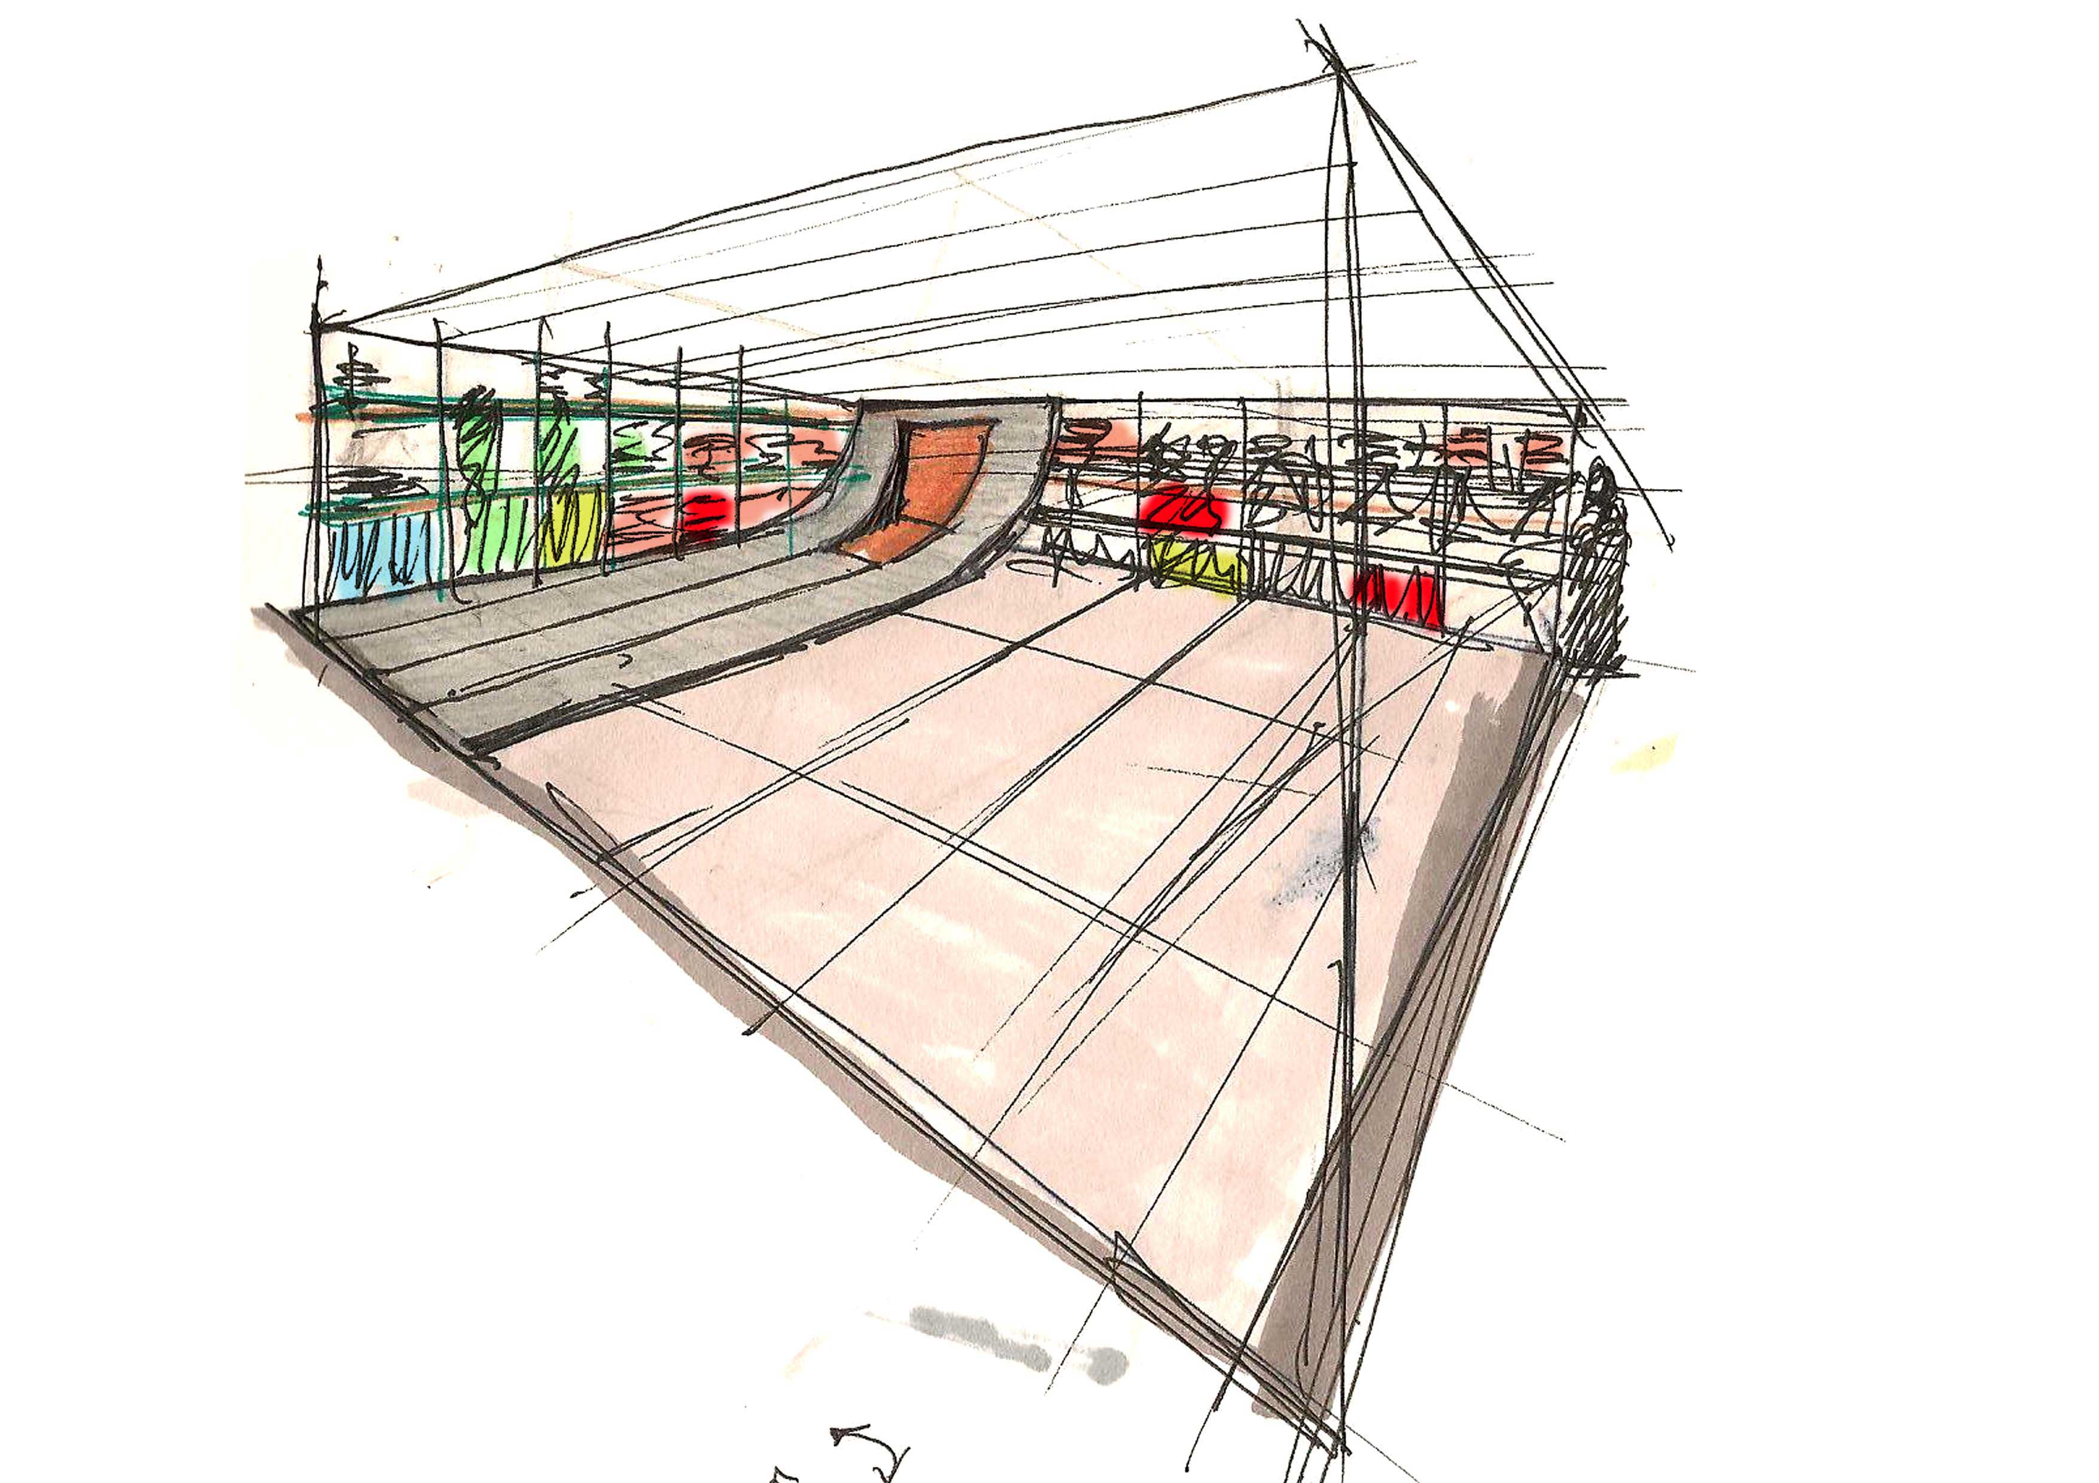
Sketching and Diagramming are usually parts of a design process

Slide 44
Studying views from the interior in a floor plan diagram

Slide 45
Physical models are used to study design ideas

Slide 46
study models may be quite simple

Slide 47
study models may be complex

Slide 48
study models may be quite abstract in character this one is mostly about mass and shape

Slide 49
study models may be quite realistic/representational of shape, or detail, or color, or material

Slide 50
study models may lead a designer to discover new forms and/or new ways of designing

Slide 51
Human Behavior: Analysis and Influence
The best design changes human behavior.
Matching desired behaviors with design proposals for achieving those behaviors. Physical layout of spaces literally ‘controls’ how people move through a built environment.
Architectural design can have strong effects on social behavior and user mood and productivity and, to some extent, design features can affect health and well being.

Slide 52
Human behavior is an important topic for psychologists, sociologists, anthropologists, historians, physicians and architects and interior designers

Slide 53
Studying human behavior

Slide 54
Architecture and Interiors play a role in influencing human behavior

Slide 55
Interior design can literally control how and where you move through spaces, and what perspective you can have on that spatial environment

Slide 56
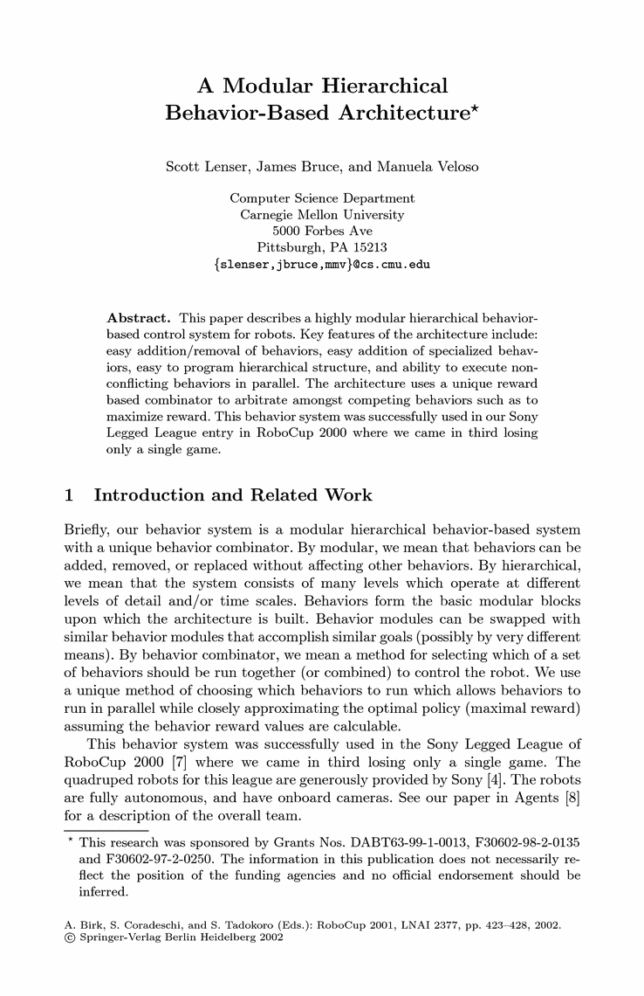
Studying human behavior

Slide 57
Space and Form
Three dimensional space and its impact upon occupants
Two dimensional forms, patterns, textures and their impact
Spatial definition and spatial organization: horizontal groupings, vertical groupings

Slide 58
House project designed by NDM Architects

Slide 59
House in Hiroshima, Japan designed by Suppose Design Office

Slide 60
Color

Slide 61
Color has been, and continues to be, a topic of much study, much of it, in my opinion, of dubious validity.
My Understanding of Color
The ‘psychology’ of color is often presented as fact, but many such claims have gone on to be disproven
The ‘physiological’ response to color has also been claimed to be identifiable but such claims have repeatedly been shown to be false.
One study disproving such claims:
The Influence of Color on Physiological Response
By: S. Freiders, S. Lee, D. Statz, and T. Kim (Group 7)

Slide 62
Does this mean that color is not important? Of course NOT!

Slide 64
Blackened Yellow! One of my personal favorite color scenarios

Slide 65
Hue: yellow tints & shades

Slide 66
Shading: Adding black to a hue (color)
Tinting: Adding white to a hue (color)

Slide 67
Burnt Orange gradient

Slide 68
Furniture, Fixtures and Equipment: FF&E
FF&E stands for Furniture, Fixtures and Equipment: these are movable furniture, fixtures or other equipment that have no permanent connection to the structure of a building or utilities.
Examples of FF&E include desks, chairs, computers, electronic equipment, tables, bookcases and partitions.
These items play an important role in how an occupant of a space functions within that environment.

Slide 69
Floor plan with FF&E keyed to show placement

Slide 70
Interior elevation drawing with FF&E keyed to show placement

Slide 71
Floor plan with FF&E keyed to show placement

Slide 72
Interior Environmental Systems and Controls
acoustics & noise control
climate control:
heating & cooling, humidity control, ventilation
plumbing:
fire supression (standpipes & sprinklers)
rest room fixtures (toilets, urinals, sinks), drinking fountains
electrical systems: lighting, security systems,

Slide 73
Legal Regulations that impact interior design and architecture
Most communities in the United States fall under the
jurisdiction of one or more sets of legal restrictions on the
way buildings can be built.
These restrictions are described in:
building codes: city, state
Americans with Disabilities Act (ADA) accessibility code:
a federal law
zoning restrictions: usually local/city
energy codes
plumbing codes
electrical codes

Slide 74
Tectonics the art and science of construction or building
A 'Prezi' presentation on Architectural Tectonics

Slide 75
Architecture, Interiors and Society
“Architecture is a physical embodiment of who we are individually and who we are as a culture.”
Professor Larry Speck, University of Texas
“The built environment has, 'a permanent and profound impact on (our) personal health, productivity and happiness, and on community life. The basis of this knowledge is found in understanding the relationship between a society and the forms it creates. ”
Professor Anne Kurtin, University of Arizona

Slide 76
Architecture, Interiors and Society
Architecture is the visual shape ("Gestalt") of society.
“Architecture is an open history book. If you can read the language of the "built environment," any street or house will have a story to tell of economics, taste, settlement, and social relationships--for every human establishment upon the landscape represents long and significant patterns of thought concerning society and architecture.”
Drexel University Architecture and Society home page, Professor Mark L. Brack.

Slide 77
Architecture, Interiors and Society
“Architecture, as a product of developed societies has left an enduring imprint as the most visible manifestation of cultural achievement.
In its reflection of a society’s aspirations, values and technological and artistic creations, architecture represents a collective continuum binding together different peoples and cultures from ancient times until the present and from one corner of the world to another.”
Miami Dade College, School of Architecture and Interior Design web page

Slide 78
Architecture, Interiors and Society
Richard Rogers: Society and Architecture (a 4 minute video)

Slide 79
Universal Design The Center for Universal Design, at North Carolina State University
Universal design is the design of products and environments to be usable by all people, to the greatest extent possible, without the need for adaptation or specialized design. –Ron Mace, Founder of The Center for Universal Design

Slide 84
Universal Design
The intent of universal design is to simplify life for everyone by making products, communications, and the built environment more usable by as many people as possible at little or no extra cost.
Universal design benefits people of all ages and abilities.

Slide 85
Universal Design Center For Universal Design: NC State University
Principles of Universal Design
Equitable use
Flexibility in use
Simple and intuitive use
Perceptible Information
Tolerance for Error
Low Physical Effort
Size and Space for Approach and Use

